Slide 1

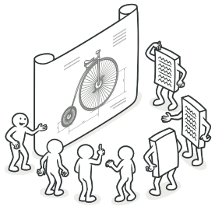
Code Quality
IT Högskolan
Hands On

Slide 2
Hands On
You need
Visual Studio 20xx
You must follow/use
S.O.L.I.D ***
Design Patterns ***
OO Principles (INI, COI)
Notes:
Starting Hands on, think on SOLID/OO Principles/Design Patterns.
Click on the text for message!

Slide 3

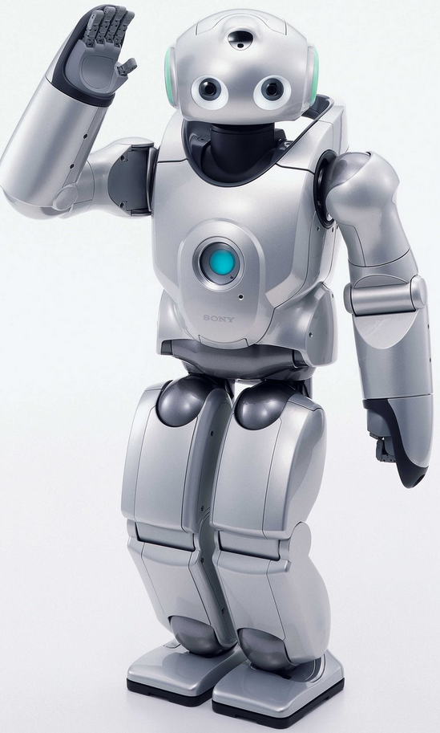

Hands On #W1
Hello, I can walk and
carry boxes.
Scenario:
Create a Robot and make the robot walk forward 5m and pick up a box then go back to starting point and set down the box. The robot can only do one thing at time. (i.e., walk or grab stuff)
Data: The Robot should keep track of its position in a 2D area.
Write action to console i.e.
‘Robot moved to position X/Y’,
“Robot picked up the box on position X/Y”,
“Robot sat down the box on position X/Y”

Slide 4
Hands On #W2
Hello,
I log everything I do.
Scenario:
Our robot must log all action he take. It should be possible to switch to any type of log-target (targets: file, debug, printer, null)
Write action to console i.e.
“ #logplace# logged: Robot moved to position X/Y”,
“#logplace# logged: Robot picked up the box on position X/Y”,
“#logplace# logged: Robot sat down the box on position X/Y”
Important:
You are NOT allowed to change any existing code, just add new one or delete existing one.

Slide 5
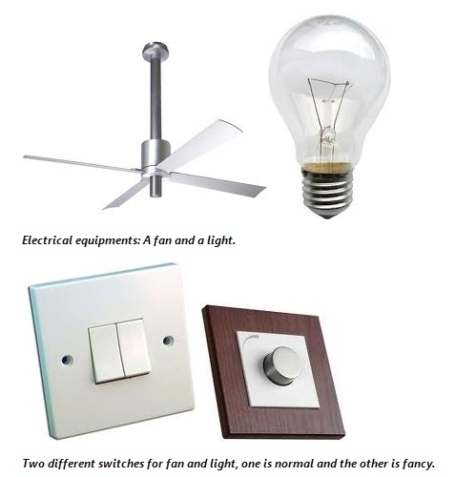
Hands On #W12
Scenario:
Our room has some electric equipment's (light, fan.). The equipment's are arranged in a way where they could be controlled by switches.
At any time, you can replace or troubleshoot an electrical equipment without touching the other things.
Write action to console i.e.
‘#switchname# switch is toggled On/Off…’
‘#unitname# is toggled On/Off…’
You have a:
- light
- fan
- standard switch
- fancy switch

Slide 6
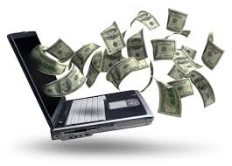
Hands On #W13
Scenario:
Implement some kind of expense approval, the developer request some money to spend (new PC). We have following roles -> Economist/The Boss/Team Leader/Developer. The Boss is allowed to approve up to 10000kr, Team Leader max 2000kr, Developer max 500kr, Economist say no to everything.
Write action to console i.e. ‘Developer approves…’

Slide 7


Hands On #W14
Scenario:
Build a traffic light. For each (5 times) Toggle you call, it should change to next light.
It should be possible to start with any color.
Write action to console i.e. ‘Red Light On…’

Slide 8

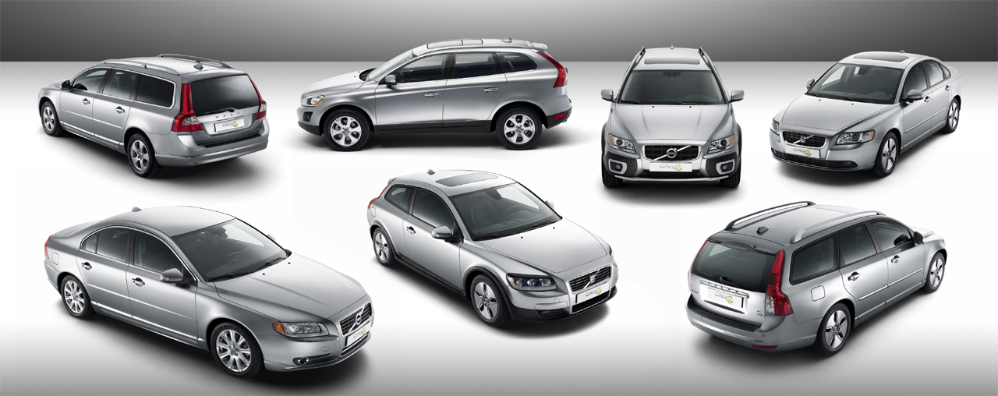
Hands On #W15
Scenario:
Bildepån in Varberg sell cars, sometimes Volvo Car’s do campaigns so they can sell more cars. Make it possible to create offers on cars without changing the car’s original property values. No inheritance on the car entity is allowed.
We have a entity: V70 (Properties: Make, Model, Price) .
Discount is 25% off price.
Write action to console i.e.
‘V70 base price are…’
‘V70 price with 25 % discount are….’

Slide 9


Hands On #W16
Scenario:
The Beatles need a way so they can communicate (Chatroom). For now, they can only send to one person at a time. Send a simple string message.
Chatroom interface: Register, UnRegister, Send
Beatle interface: Name, Send, Receive
Write to console i.e. ‘To a Beatle yyy from xxx’

Slide 10
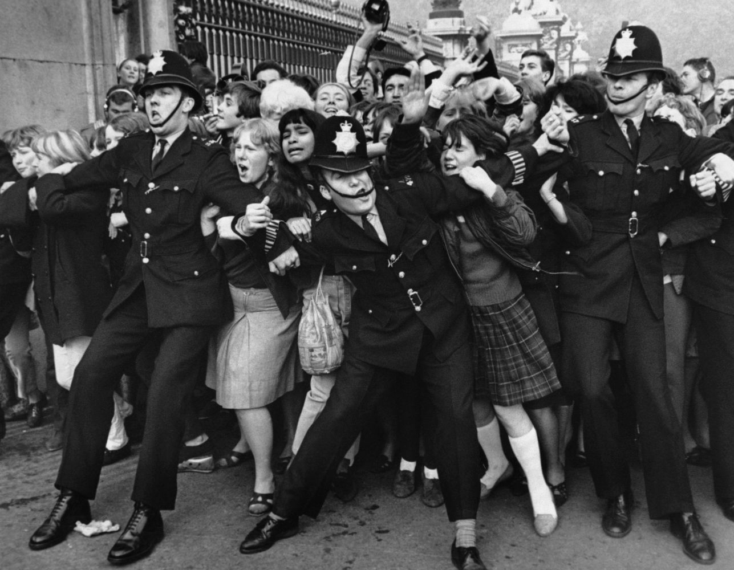
Hands On #W17
Scenario:
Fans also wants to communicate with The Beatles. Fan’s/Beatle’s can send to all or a specific Beatle;
Write to console i.e. ‘To a Beatle y from x’

Slide 11

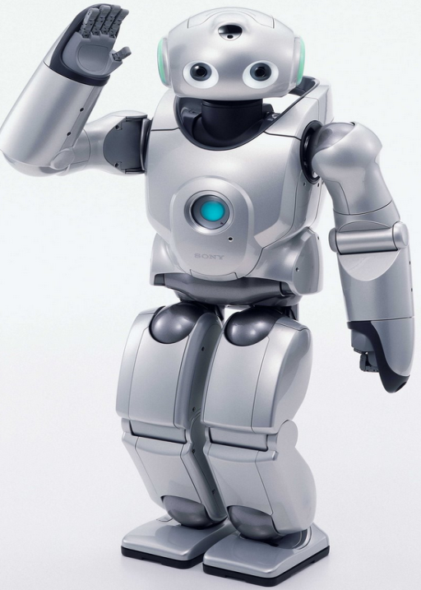
Hands On #W18
Scenario:
Design a system where we have workers and a manager for the workers. The workers should be able to ‘eat’ and ‘work’ and they have a name. The workers are assigned to the manager and he tell them to work or eat.
We have different type of workers; people, robots.
Write to console i.e. ‘(Name) is eating’; ‘(Name) is working’

Slide 12
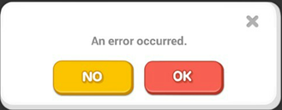

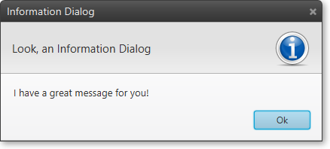
Hands On #W19
Scenario:
We need a way to notify interested parties (Recipient properties: Name, Phone, Email).
We have following ways to notify; Information message, Error message, SMS
Write to console: for ex. ‘Notifying (Name) by (Way)’
Recipient will recieve a string message.

Slide 13
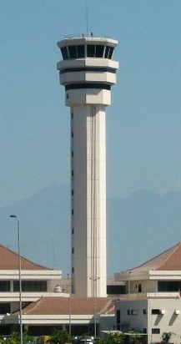
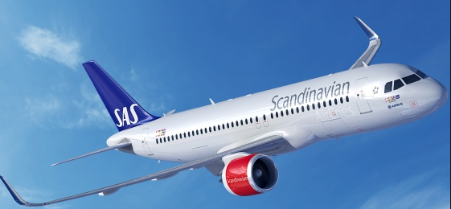
Hands On #W21
Scenario: Create a flight controller system. We have a controller tower, aircrafts (Piper, Airbus, Boeing).
A plane has following properties: Ceiling, CallSign, Altitude. It’s possible to tell planes to climb and decent. Tower recieves notification when a plane changes location.
Rule: When a plane is closer than 1000m to another plane the tower should order notifying plane to climb 1000m.
Write to console (Example):
‘Tower order #name to climb 1000 meters.’
’ #name is climbing to yyy meters.’
’ #name is climbing to maimum height yyy meters.’
’ #name is getting warning that my airspace is compromized by #name’
’ #name will crash! Altitude set to yyy meters.’

Slide 14


Hands On #W22
Scenario:
You working as an Barista. There are multiple varieties of Coffee and Tea available.
Make it possible to create a cup of Coffee or Tea with any combination of this options:
Type(Coffee, Tea)
Adding's(Sugar, Milk)
Rules:
The drink is always served in a Cup.
It should be possible to add/remove any type of drink without any code changes.
Write to console (example):
‘Boiling water’
‘Creating Tea.’
‘Adding Milk’

Slide 15
Hands On #W23
Scenario:
You working as an Barista. There are multiple varieties of Coffee (Description, Cost) available.
Make it possible to create a cup of Coffee with any combination of this types/options:
Type(DarkRoast, Decaf, Expresso, HouseBlend)
Adding's(Sugar, Milk, Whip)
Rules:
The drink is always served in a Cup.
It should be possible to add/remove any type of drink without any code changes.
Write to console (example):
‘Creating #name#’
‘Boiling water’
’Filling with Description’
’Beverage (Description), Cost = Cost’

Slide 16

Hands On #W25
Scenario: We have a Bank (SwedBank) with accounts where you can Deposit or Withdraw money. The bank give no interest rate for any account. Every account are allowed to have credit (max: 1500)
Write to console, for example:
’ YYY deposit: xxx’
’ YYY withdrew: xxx’
‘YYY have balance xxx’
’YYY have no funds!’

Slide 17
Hands On #W26
Scenario: We have a Bank (SwedBank) with accounts where you can Deposit or Withdraw money. The bank give interest rate for any account, interest are calculated after every deposit. Interest is given if total amount > 500. Maximum amount to give interest is 1 Million.
Every account are allowed to have credit (max: 1500)
Write to console, for example:
’ YYY deposit: xxx’
’ YYY interest Earned: xxx’
’ YYY withdrew: xxx’
‘YYY have balance xxx’
’YYY have no funds!’

Slide 18
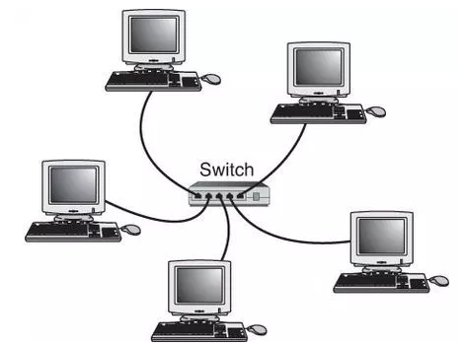
Hands On #W27
Scenario: We are starting to build a network. At start we only have a local hub and some connected computers.
Hub/Computers can send messages to one computer. Hub/Computer can broadcast message to all.
Write to console, for example:
’Computer(xxx) sending message to Computer(yyy)’
’Computer(yyy) received message from Computer(xxx)’
’Computer(yyy) broadcasting message.’

Slide 19

Hands On #W28
Scenario: We want to build a internet network. We want countries/regions/computers to be connected. Computers can send messages to one computer. Each level can broadcast message to all on same level and below.
We have:
Countries: Sweden/Norway/Denmark
Regions: Varberg/Oslo/Copenhagen, each region has 2 computers.
Write to console, for example:
’Internet broadcasting message.’
’Computer(xxx) sending message to Computer(yyy)’
’Computer(yyy) received message from Computer(xx)’
’Computer(yyy) broadcasting message.’

Slide 20

Hands On #W29
Scenario:
Create a football game. We have 7 players and a referee. Every participant should keep track of the balls position.
Move the ball and write to console:
“xxType ‘Name’ say that the ball is at (x,y,z)”

Slide 21
Hands On #W30
Scenario:
Create a football game. We have 7 players and a referee. Every participant should keep track of the balls position. At least 3 players (can shift) will play the role of defender. A player can dribble with the ball/passing the ball/shot goal. Defenders can’t dribble. Goalkeeper saves shoot’s.
Move the ball and write to console:
“xxType ‘Name’ say that the ball is at (x,y,z)”
“xxType ‘Name’ passes the ball!”
“xxType ‘Name’ scores a goal!”
“xxType ‘Name’ dribble's successfully!”
“Defender ‘Name’ should not dribble!”
“Goalkeeper ‘Name’ saved the shot!”

Slide 22
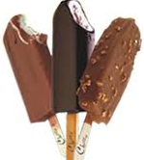


Hands On #W31
Scenario:
We need a way to ordering ice-cream online. There are multiple varieties of the ice creams available currently in the market. Each person has different choices of toppings, flavors etc.
Make it possible to create ice-cream with any combination of this options:
Flavor (Vanilla/Banana/Chocolate)
Caramel (int spoon)
Peanuts (int spoon)
Cherry (int number)
Type (Bar, Coon, Glass)
Write to console: ‘Ice-Cream of Type (Type) with (Options) created.’

Slide 23
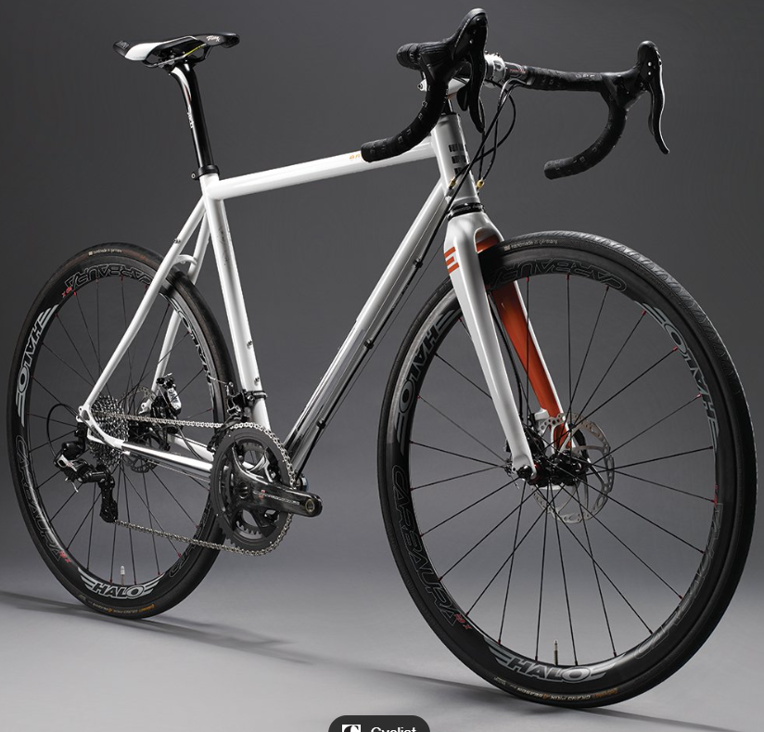
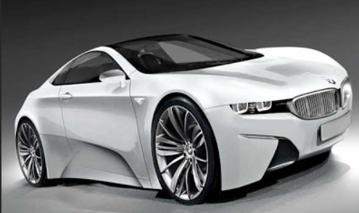
Hands On #W32
Scenario:
We need a way to build different kind of vehicles.
Make it possibly to build Cars, Bicycles.
Options cars: 2/4 wheel drive, color
Type cars: Volvo, BMW
Options bicycle: gears (10, 11), color
Type bicycle: Racer, MTB
Write to console, Ex:
“Building car/bicycle of Type (Type) with (Options).”
“My Volvo has color White and is a AWD!”
“My MTB has 10 gears and color White!”

Slide 24
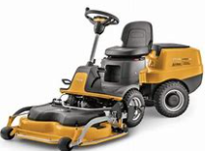
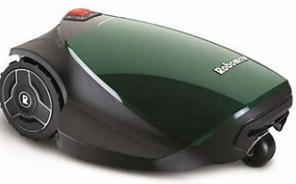
Hands On #W33
Scenario:
We need 2 types of lawnmowers (AutoMover, RidingLawMower). They have a ArticleNumber, a Brand, a Fuel type (Petrol, Electricity).
The AutoMover also have the possibility to set a time, to set a starttime and how long time to run. It can be started and stopped.
The RidingLawMower also have the possibility to set the seat as SpringSeat or not.
We also have a Stock that contain all lawnmowers and it keep a record of the saldo in the stock. It’s possible to Add/Remove lawnmower from the Stock, it’s possibly to print out the total list of mowers and also to print a list of a specific type of mowers.
Write to console, Ex:
“Mowers in stock”
“ArtNr: xxx Brand: xxx Type of fuel: xxx”
“Auto Mowers in stock”
“ArtNr: xxx Brand: xxx Type of fuel: xxx Start: xxxx Active: xx”
“Riding Lawn Mowers in stock”
“ArtNr: xxx Brand: xxx Type of fuel: xxx Has SpringSeat: xx”

